Slide 1
Dataset Distillation
刘展宇
zhyliu00@sjtu.edu.cn
Notes:
Good afternoon everyone, I’m Liu Zhanyu. I’m a fourth-year Ph.D. student major in computer science. Today, I’m going to give a brief tutorial about dataset distillation. So let’s get started.

Slide 2
Dataset Distillation
Data = Information + Noise
How to identify the most critical information from the dataset?
Dataset Distillation is a promising solution
Notes:
As we know, the dataset is composed of useful information and the noise.
What we want to do in the deep learning scenario is to identify the most critical information from the dataset for the downstream tasks.
For example, if we want to train a neural network models for downstream tasks such as regression and classification, we could use the identified critical information to effectively and efficiently train the model.
In this context, dataset distillation is a promising solution to achieve this.

Slide 3
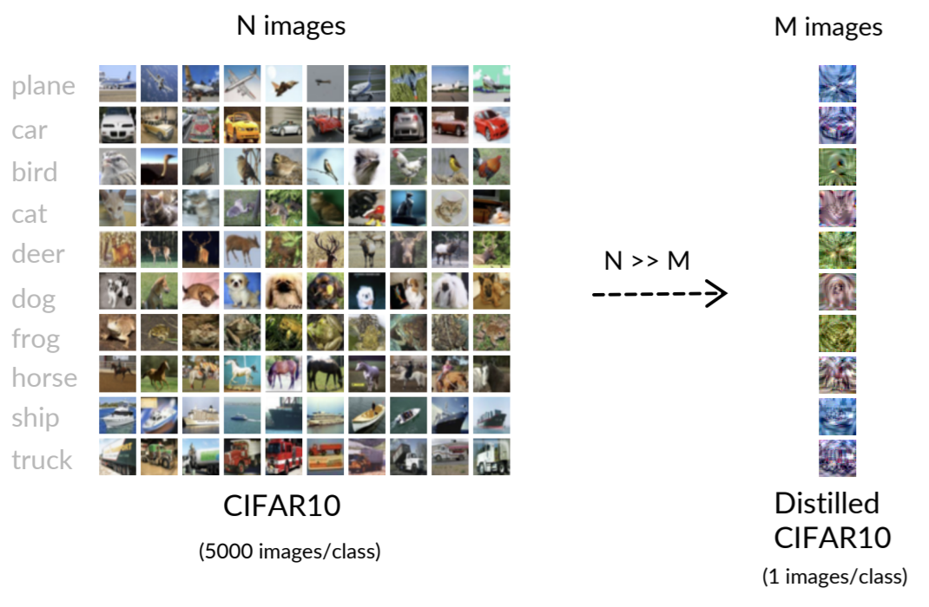
What is Dataset Distillation?
For example: CIFAR10 dataset
Wu, X., Zhang, B., Deng, Z., & Russakovsky, O. (2023). Vision-language dataset distillation.
Notes:
So let’s start with an example.
Here is a image dataset CIFAR10, where there are 10 classes of images and each class contains 5000 images.
So after dataset distillation, we get a small synthetic dataset, where each class contains only one image.
In this small synthetic dataset, the robust and critical knowledge is distilled from the original dataset.

Slide 4
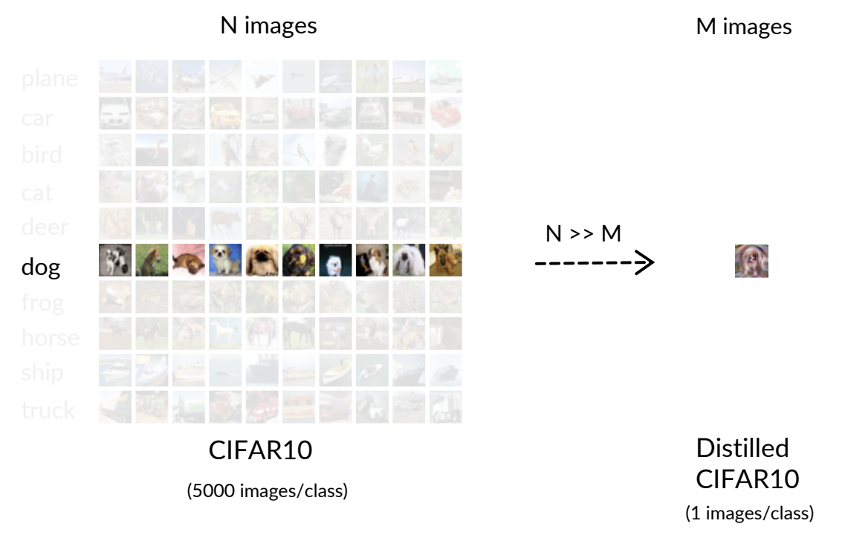
What is Dataset Distillation?
For example: CIFAR10 dataset
Wu, X., Zhang, B., Deng, Z., & Russakovsky, O. (2023). Vision-language dataset distillation.
Notes:
If we probe in this synthetic data, we will find something interesting.
For example, let’s look at the class dog in both original dataset and distilled image

Slide 5
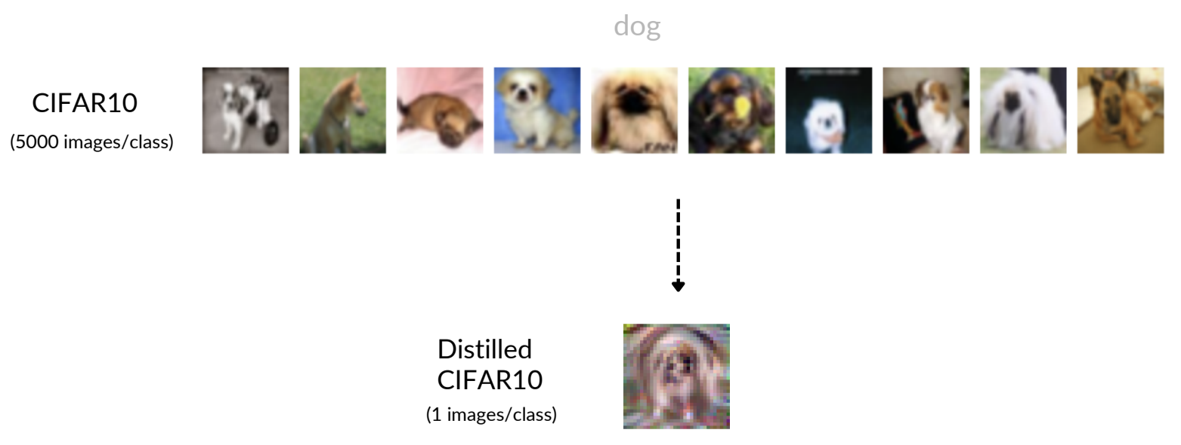
What is Dataset Distillation?
For example: CIFAR10 dataset
Wu, X., Zhang, B., Deng, Z., & Russakovsky, O. (2023). Vision-language dataset distillation.
Notes:
Here, the dog images in original dataset contains various types of dogs, and the ages of the dogs, the background of the images are different.
But if we look at the distilled image, we will find a robust pattern of the dog, it looks like the general face and general body of dogs.
So, we can say that the distilled image contains the critical knowledge of the original dataset.
Meanwhile, since the dataset is synthetic, which means they are learned from some optimizing objective, they are not the same to any real data.
If you are familiar with pytorch, the synthetic data is initialized with torch nn parameter, and they are updated by back propagation.

Slide 6
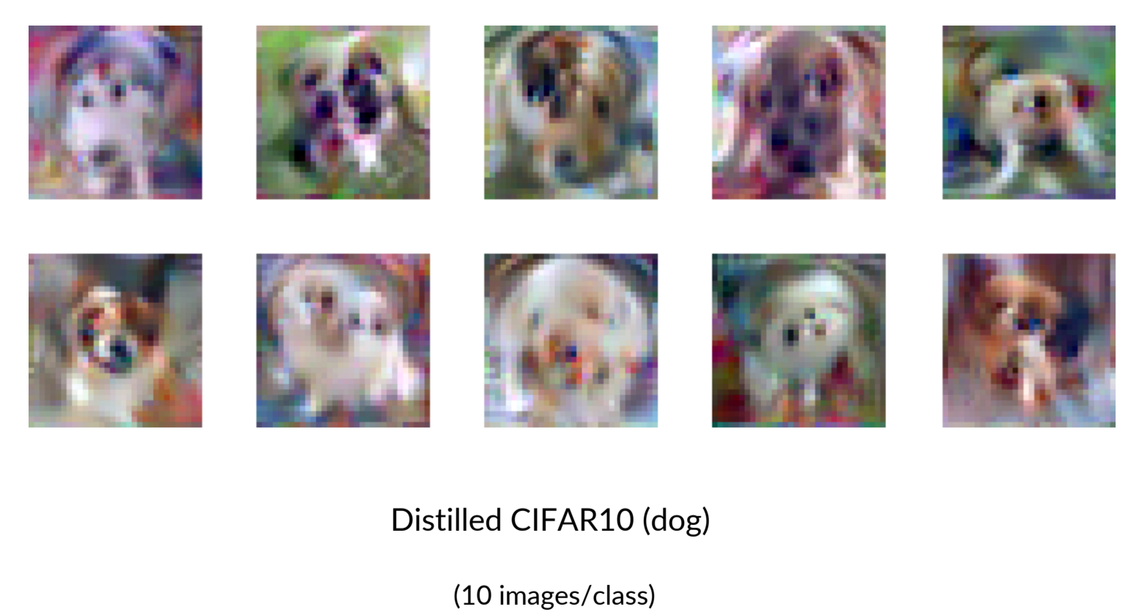
What is Dataset Distillation?
For example: CIFAR10 dataset
Wu, X., Zhang, B., Deng, Z., & Russakovsky, O. (2023). Vision-language dataset distillation.
Notes:
Furthermore, if we use more space for distilled synthetic dataset, we will find that more synthetic images brings more patterns of original dataset.
Here, we add the number of synthetic images from 1 to ten, and we still investigate the dog images.
We can see that these images brings more patterns of dogs.
It seems that these images capture different types different colors and different background of dog images.

Slide 7
What is Dataset Distillation?
Loose Definition
Approaches that aim to synthesize tiny and high-fidelity data summaries the most important knowledge from a given target dataset.
Such distilled summaries are optimized to serve as effective drop-in replacements of the original dataset for efficient and accurate data-usage applications.
Application
Neural Architecture Search
Continual Learning
Federated Learning
Privacy
Neural Architecture Search
Distilled dataset
Search
Model Pool
Good Efficiency
Full dataset
Search
Model Pool
Bad Efficiency
Continual Learning
Distill
Old data
Small data
Model training
Effective in both new and old data
New data
Sachdeva, Noveen, and Julian McAuley. "Data distillation: A survey." TMLR, 2023.
Notes:
Let’s give a loose definition of dataset distillation.
Here, we define dataset distillation is a approach that aims to synthesize tiny and high-fidelity data that summaries the most important knowledge from a given target dataset.
After we get the tiny and high-fidelity data, we can directly use it as a effective drop-in replacements of the original dataset for the efficient and accurate data-usage applications.
For example, the distilled dataset could serve in various downstream tasks.
First, in neural architecture search, we want to get the most effective model with the highest training accuracy from a model pool. However, directly train each model from the model pool with the original dataset is expensive.
So, if we use the distilled dataset that has only 1% size of the size of the original dataset, we can improve the efficiency to a large scale.
In the continual learning task, we have a model that is trained by some historical data.
Meanwhile, we have some new data and we want to fuse the knowledge from the new data to the model.
If we directly train the model with the new data, the model could forget the knowledge from the old data, and perform bad in the old tasks.
This is so-called catastrophical forgetting problem.
To avoid this problem, we want to fuse the knowledge of the old data to the training process of the new data.
In this scenario, we could firstly distill the old data to a small synthetic data, and use new datasets and old synthetic datasets for joint training.
This could lead to better performance in both new and old dataset.
In federated learning, some users want to jointly train a model with their private data while protect the privacy and guarantee the efficiency.
In this circumstantce, they could firstly distill their private dataset to a small synthetic dataset, and then share the synthetic dataset to other users.
Since the synthetic dataset is small, and as I showed, the synthetic dataset is very different from the original dataset, using synthetic dataset in federated learning could bring both efficiency and privacy.

Slide 8
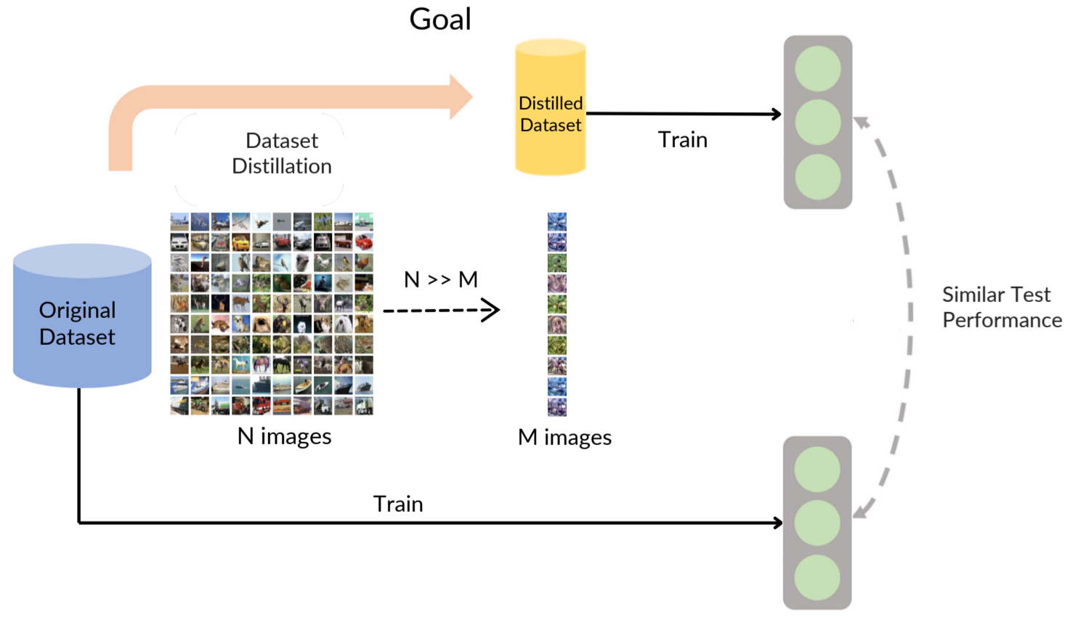
What is Dataset Distillation?
Task:
Learn a synthetic dataset S from the original dataset T
Train a model with S
The performance of S and T is similar
Yu, Ruonan, Songhua Liu, and Xinchao Wang. "Dataset distillation: A comprehensive review." arXiv preprint arXiv:2301.07014 (2023).
Notes:
So, let’s formally formulate the dataset distillation task.
The task is to learn a synthetic dataset S from the original dataset T.
And what we want to achieve is that, we train a model with the synthetic dataset S and we train another model with real data T, and we want to guarantee the performance of the both model is similar.
Shown in figure.

Slide 9
Previous Work

Slide 10
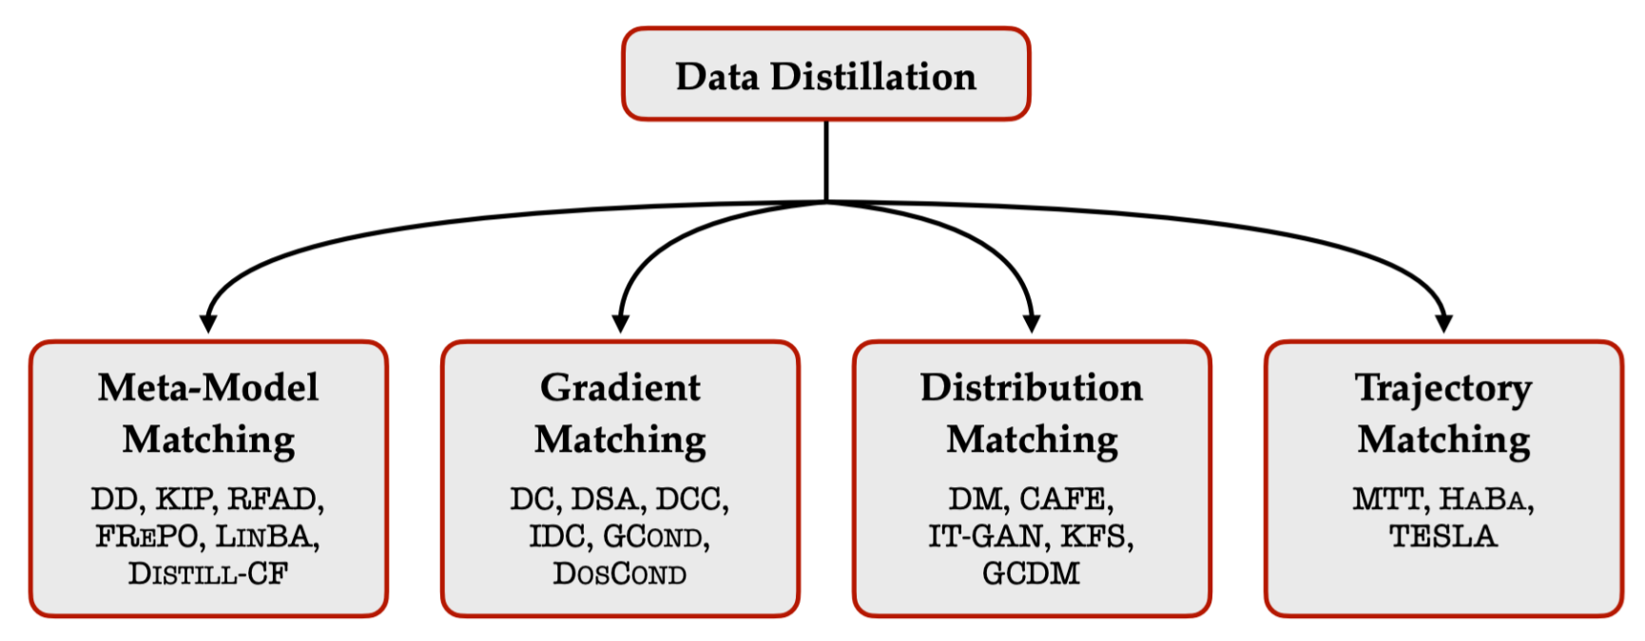
Previous Work
Sachdeva, Noveen, and Julian McAuley. "Data distillation: A survey." TMLR, 2023.
Notes:
Meta model matching framework: bi-level optimizing to directly make better performance
Make the model trained by synthetic data and real data has similar gradient
Make the embedding generated by synthetic data and real data has similar distribution
Make the model trained by synthetic data and real data has similar multi-step gradient, which is so-called trajectory here.

Slide 11
Previous Work
Meta-Model Matching
Gradient Matching
Trajectory Matching
Distribution Matching

Slide 12
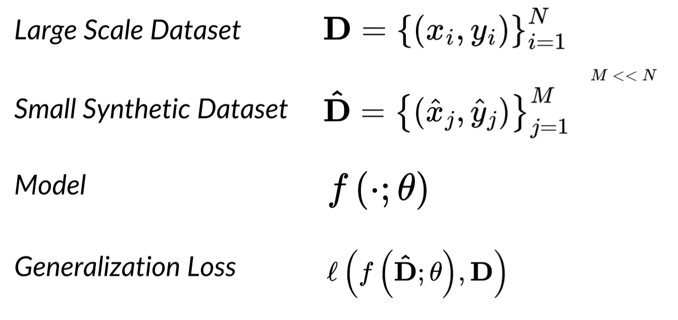
Previous Work
Meta-Model Matching Framework
Dataset distillation can be formulated as a bi-level meta-learning problem
Goal: Optimize the performance on real data of the model trained on synthetic data.
Wu, X., Zhang, B., Deng, Z., & Russakovsky, O. (2023). Vision-language dataset distillation.

Slide 13
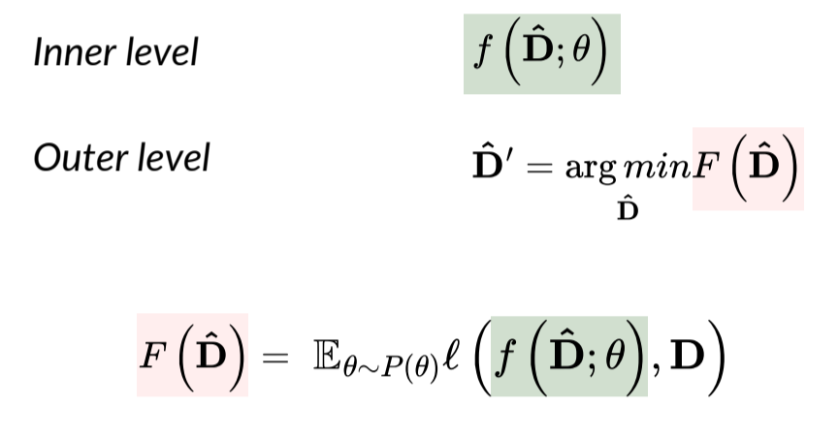
Previous Work
Meta-Model Matching Framework
Dataset distillation can be formulated as a bi-level meta-learning problem
Goal: Optimize the performance on real data of the model trained on synthetic data.
Wu, X., Zhang, B., Deng, Z., & Russakovsky, O. (2023). Vision-language dataset distillation.

Slide 14
Previous Work
Meta-Model Matching Framework - DD
Random initialize synthetic data
Random sample real data and initial parameter (Line 3, Line 4)
One-step optimize the sampled parameter with the synthetic data, get $θ_{1}$ (Line 6)
Calculate the loss of real data based on $θ_{1}$ (Line 7)
Back-propagation to update the synthetic data (Line 9)
Wang, T., Zhu, J. Y., Torralba, A., & Efros, A. A. (2018). Dataset distillation. arXiv preprint arXiv:1811.10959.

Slide 15
Previous Work
Meta-Model Matching
Gradient Matching
Trajectory Matching
Distribution Matching

Slide 16
Previous Work
Gradient Matching
Goal: the gradient of a model trained on synthetic data and real data is similar
Zhao, B., Mopuri, K. R., & Bilen, H. (2020). Dataset condensation with gradient matching. arXiv preprint arXiv:2006.05929.

Slide 17
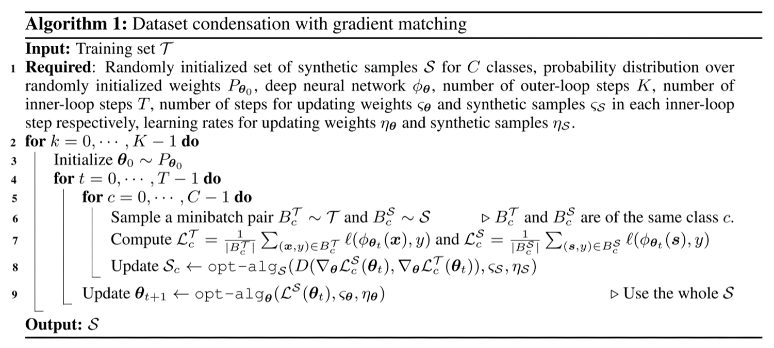
Previous Work
Gradient Matching
Given a $θ_{0}$ of a model (Line 3)
Train $θ_{0}$ on synthetic data $s$ and real data $x$ respectively (Line 7)
Match the one-step gradient (Line 8)
Zhao, B., Mopuri, K. R., & Bilen, H. (2020). Dataset condensation with gradient matching. arXiv preprint arXiv:2006.05929.

Slide 18
Previous Work
Meta-Model Matching
Gradient Matching
Trajectory Matching
Distribution Matching

Slide 19
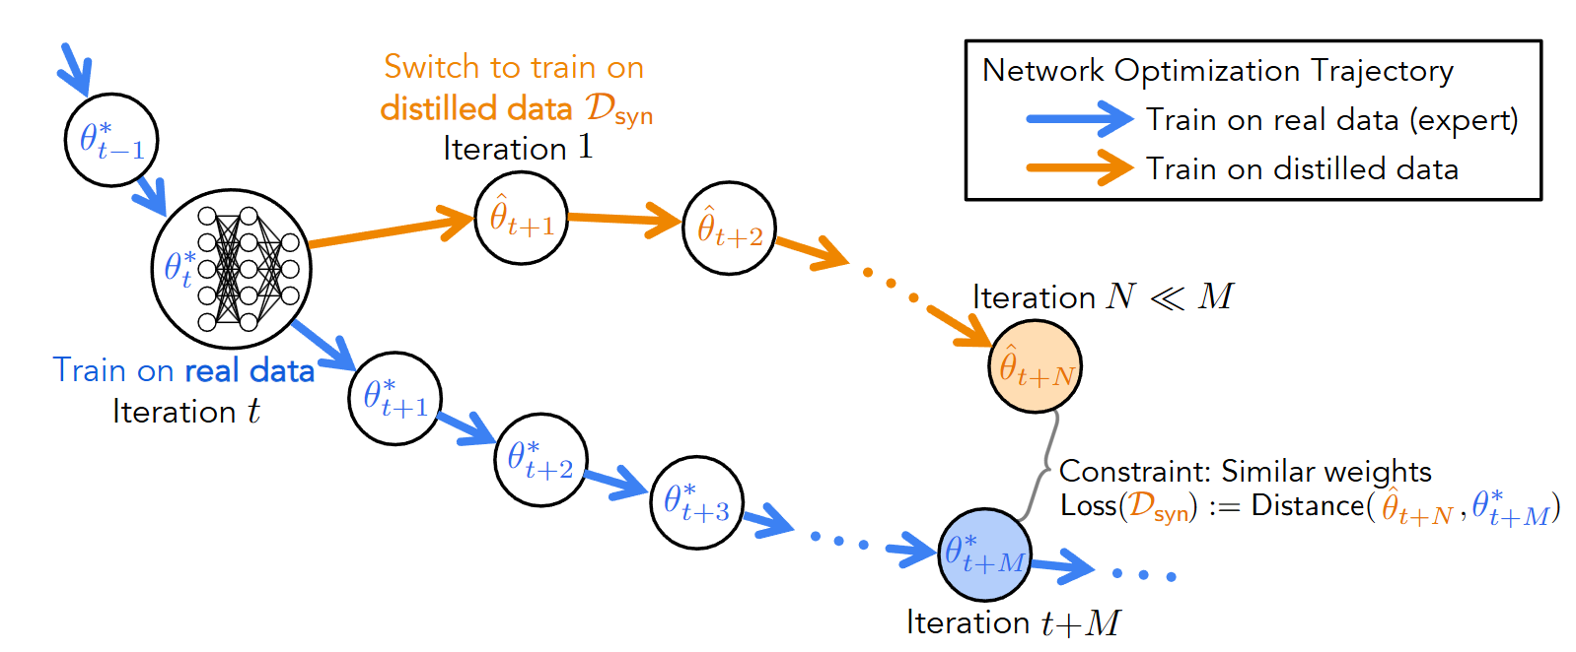
Previous Work
Trajectory Matching
Goal: The multi-step gradient of a model trained on synthetic data and real data is similar
Cazenavette, G., Wang, T., Torralba, A., Efros, A. A., & Zhu, J. Y. (2022). Dataset distillation by matching training trajectories. In Proceedings of the IEEE/CVF Conference on Computer Vision and Pattern Recognition (pp. 4750-4759).

Slide 20
Previous Work
Meta-Model Matching
Gradient Matching
Trajectory Matching
Distribution Matching

Slide 21
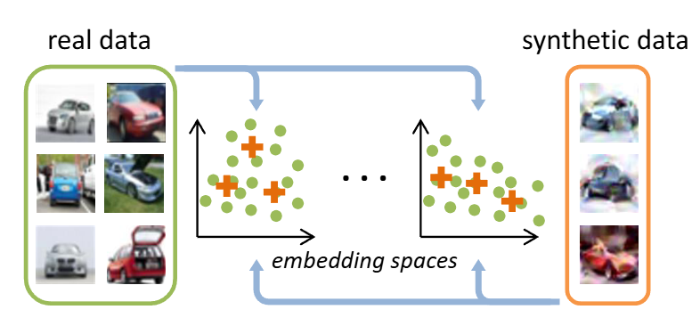
Previous Work
Distribution Matching
Goal: The hidden states of the synthetic data and real data on the model is similar
Zhao, B., & Bilen, H. (2023). Dataset condensation with distribution matching. In Proceedings of the IEEE/CVF Winter Conference on Applications of Computer Vision (pp. 6514-6523).

Slide 22
Previous Work
Distribution Matching
Goal: The hidden states of the synthetic data and real data on the model is similar
Sample a random parameter $θ$ (Line 3)
Calculate the distribution MSE error (Line 5)
Zhao, B., & Bilen, H. (2023). Dataset condensation with distribution matching. In Proceedings of the IEEE/CVF Winter Conference on Applications of Computer Vision (pp. 6514-6523).

Slide 23
Distillation for Different Data

Slide 24
Distillation for Different Data
Image
Graph
Dataset Distillation
Multimodal
Time Series

Slide 25
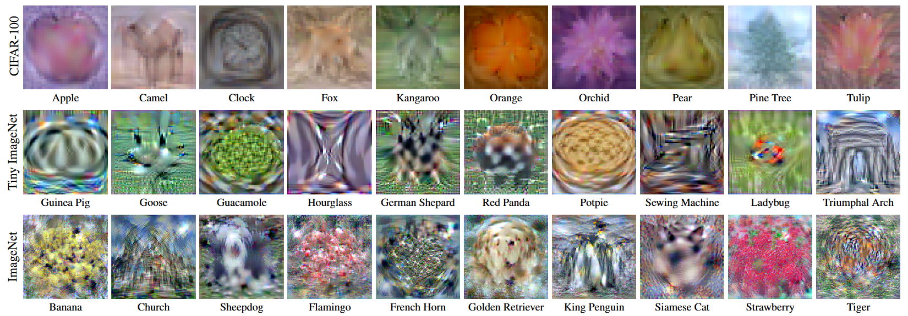
Image
Image Data Distillation
Input: Real Training Data X
Output: Synthetic Data S
$$θ_{0}$$
…
$$\hat{θ_{M}}$$
Model Training
X
Mean Square Error
S
$$θ_{0}$$
…
$$\overline{θ_{N}}$$
Update
Cazenavette, G., Wang, T., Torralba, A., Efros, A. A., & Zhu, J. Y. (2022). Dataset distillation by matching training trajectories. In Proceedings of the IEEE/CVF Conference on Computer Vision and Pattern Recognition (pp. 4750-4759).

Slide 26
Graph
Graph Data Distillation
X
Model Training
Input: Real Training Data X, A
Output: Synthetic Data X’, A’
$$θ_{0}$$
…
$$\hat{θ_{M}}$$
A
Mean Square Error
X’
…
$$θ_{0}$$
$$\overline{θ_{N}}$$
A’
Update
Jin, W., Zhao, L., Zhang, S., Liu, Y., Tang, J., & Shah, N. (2021). Graph condensation for graph neural networks. arXiv preprint arXiv:2110.07580.

Slide 27
Graph
Graph Data Distillation
X
…
Model Training
$$θ_{0}$$
$$\hat{θ_{M}}$$
Input: Real Training Data X, A
Output: Synthetic Data X’, A’
A
Mean Square Error
X’
…
$$θ_{0}$$
$$\overline{θ_{N}}$$
A’
Update
Challenge:
The Adjacency matrix of the synthetic data A’ is not updated
How to model the adjacency matrix? $→$ Use the Self-expressive Graph
set First Order Derivative to 0
Liu, Z., Zeng, C., & Zheng, G. (2024, August). Graph data condensation via self-expressive graph structure reconstruction. In Proceedings of the 30th ACM SIGKDD Conference on Knowledge Discovery and Data Mining (pp. 1992-2002).

Slide 28
Graph
Graph Data Distillation
X
…
Model Training
$$θ_{0}$$
$$\hat{θ_{M}}$$
Input: Real Training Data X, A
Output: Synthetic Data X’, A’
A
Mean Square Error
X’
…
$$θ_{0}$$
$$\overline{θ_{N}}$$
A’
Update
Challenge:
The Adjacency matrix of the synthetic data A’ is not updated
How to model the adjacency matrix? $→$ Use the Self-expressive Graph
set First Order Derivative to 0
Liu, Z., Zeng, C., & Zheng, G. (2024, August). Graph data condensation via self-expressive graph structure reconstruction. In Proceedings of the 30th ACM SIGKDD Conference on Knowledge Discovery and Data Mining (pp. 1992-2002).

Slide 29
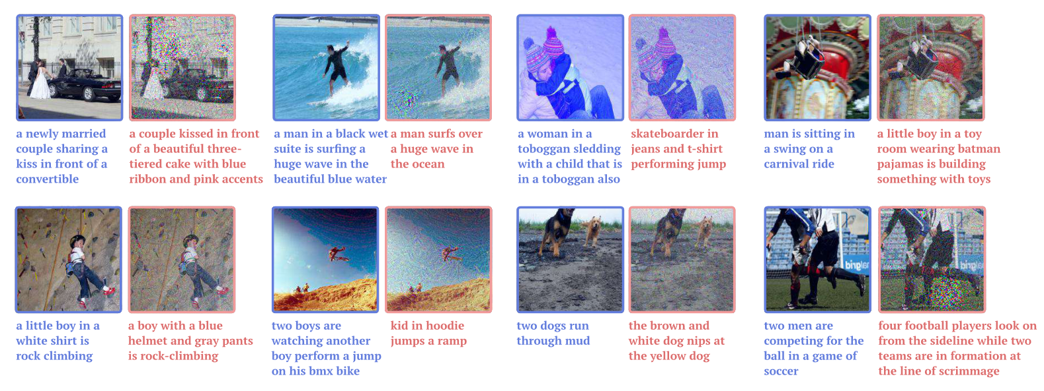
Multimodal
Multimodal Data Distillation
Input: Real Vision-Language Pairs (I, T)
Output: Synthetic Vision-Language Pairs (I, T)
Wu, X., Zhang, B., Deng, Z., & Russakovsky, O. (2023). Vision-language dataset distillation.

Slide 30
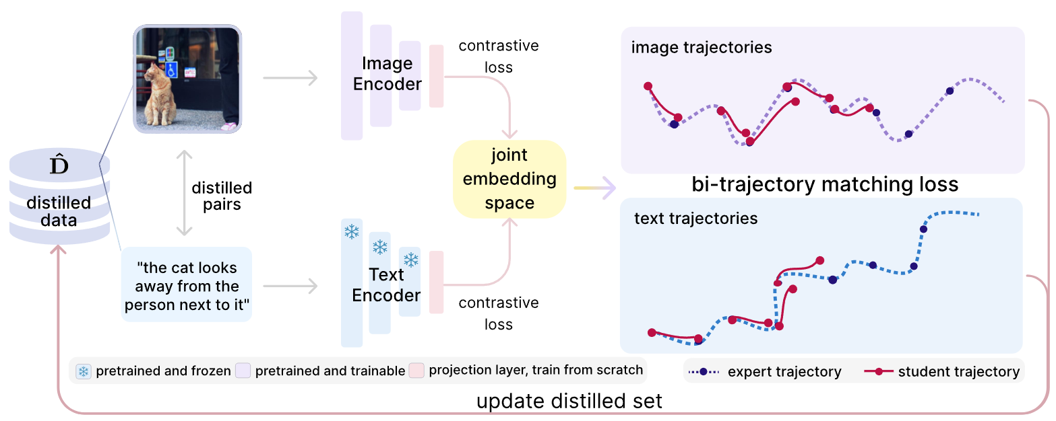
Multimodal
Multimodal Data Distillation
Input: Real Vision-Language Pairs (I, T)
Output: Synthetic Vision-Language Pairs (I, T)
Challenge:
There is no label, ant thus no classification loss. (No Guidance)
The text is discrete, and thus is not optimizable. (Discrete)
Method:
Use contrastive loss as guidance
Use the text embedding as the optimization target
Wu, X., Zhang, B., Deng, Z., & Russakovsky, O. (2023). Vision-language dataset distillation.

Slide 31
Multimodal
Multimodal Data Distillation
Input: Real Vision-Language Pairs (I, T)
Output: Synthetic Vision-Language Pairs (I, T)
Method:
Use contrastive loss as guidance
Use the text embedding as the optimization target
Wu, X., Zhang, B., Deng, Z., & Russakovsky, O. (2023). Vision-language dataset distillation.

Slide 32
Time Series
Time Series Data Distillation
X
$$θ_{0}$$
…
$$\hat{θ_{M}}$$
Model Training
Input: Real time series data X
Output: Synthetic time series data S
Mean Square Error
S
$$θ_{0}$$
…
$$\overline{θ_{N}}$$
Liu, Z., Hao, K., Zheng, G., & Yu, Y. (2024, August). Dataset condensation for time series classification via dual domain matching. In Proceedings of the 30th ACM SIGKDD Conference on Knowledge Discovery and Data Mining (pp. 1980-1991).

Slide 33
Time Series
Time Series Data Distillation
Input: Real time series data X
Output: Synthetic time series data S
Challenge:
Time series data has rich information in frequency domain
Method:
Project the data to multiple Frequency-enhanced feature space.
Matching the training dynamics (gradient, distribution) in both time and frequency domain.
Liu, Z., Hao, K., Zheng, G., & Yu, Y. (2024, August). Dataset condensation for time series classification via dual domain matching. In Proceedings of the 30th ACM SIGKDD Conference on Knowledge Discovery and Data Mining (pp. 1980-1991).

Slide 34
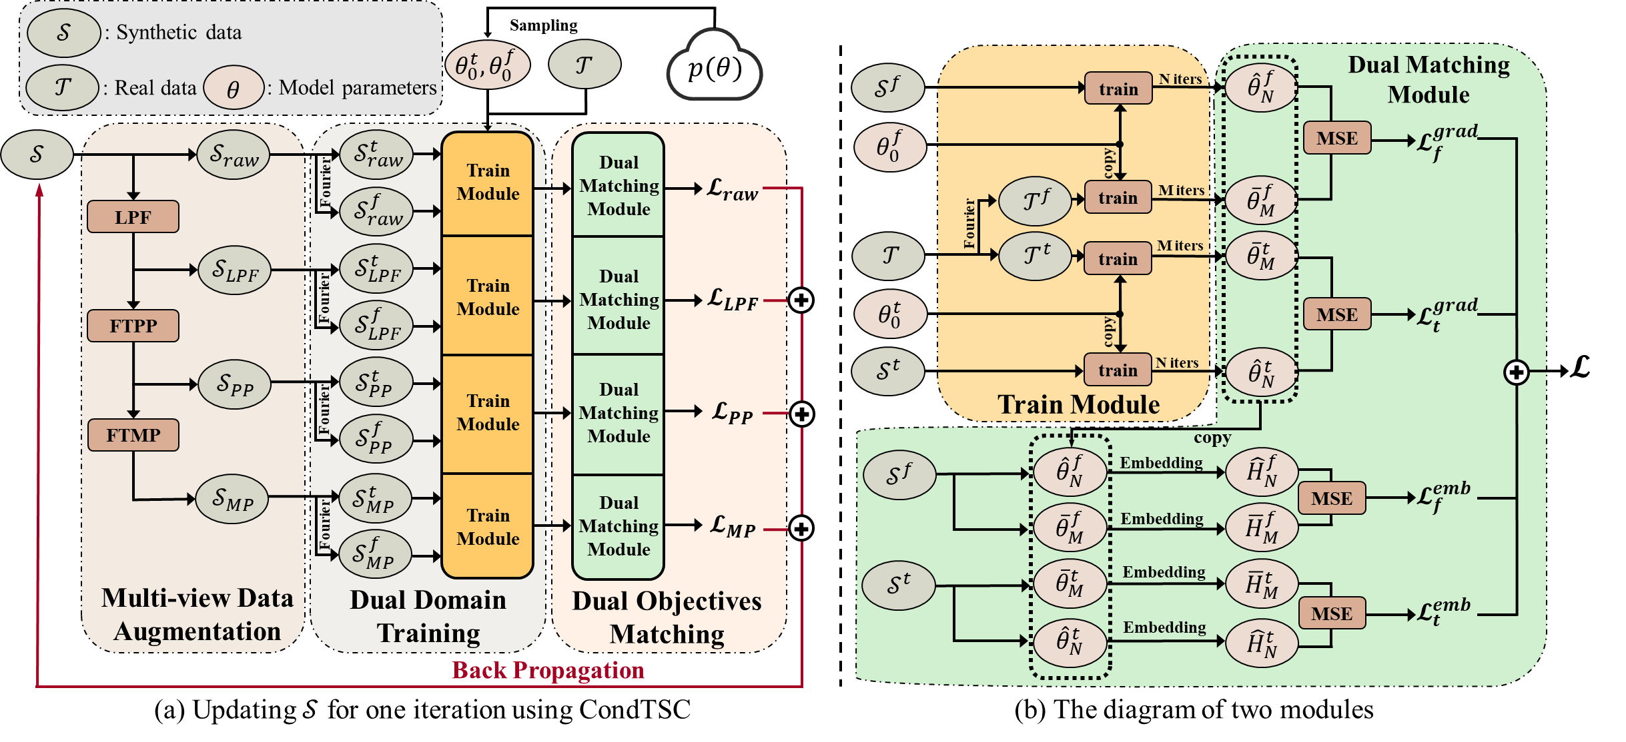
Time Series
Time Series Data Distillation
Input: Real time series data X
Output: Synthetic time series data S
Method:
Project the data to multiple Frequency-enhanced feature space.
Matching the training dynamics (gradient, distribution) in both time and frequency domain.
Liu, Z., Hao, K., Zheng, G., & Yu, Y. (2024, August). Dataset condensation for time series classification via dual domain matching. In Proceedings of the 30th ACM SIGKDD Conference on Knowledge Discovery and Data Mining (pp. 1980-1991).

Slide 35
Our Work (Dataset Distillation)

Slide 36
Time Series Classification
What is Time Series Classification?
Ismail Fawaz, H., Forestier, G., Weber, J., Idoumghar, L., & Muller, P. A. (2019). Deep learning for time series classification: a review. Data mining and knowledge discovery, 33(4), 917-963.

Slide 37
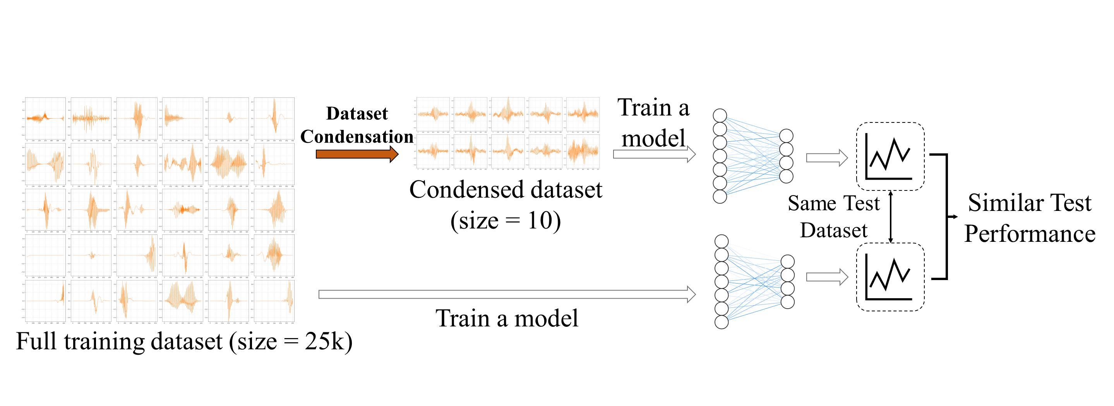
For Time Series Classification – KDD 2024
Why not previous methods?
Previous methods focus on images and graphs.
The rich information in frequency domain is not utilized
How to utilize the frequency domain information?
We project the dataset into multiple frequency-enhanced space
We match the training dynamics in both time domain and frequency domain.
Liu, Z., Hao, K., Zheng, G., & Yu, Y. (2024, August). Dataset condensation for time series classification via dual domain matching. In Proceedings of the 30th ACM SIGKDD Conference on Knowledge Discovery and Data Mining (pp. 1980-1991).
Notes:
So, for the previous data condensation methods, why are they not able to solve the time series dataset condensation problem?
Previous methods are mainly focusing on the image data and the graph data.
Different from the other modalities, time series data exhibits distinct characteristics, such as periodicity and seasonality.
These characteristics are closely related to its frequency domain, but the information within it is not fully utilized.
So, in this paper, we present our frame work CondTSC to fully utilize the information contained in the both time domain and frequency domain.
Essentially, we first project both the synthetic data into multiple frequency-enhanced spaces and then match the training dynamics of the synthetic data and the real training data in both time domain and frequency domain.

Slide 38
For Time Series Classification – KDD 2024
Dataset Condensation for Time Series Classification via Dual Domain Matching (CondTSF)
Multi-view Data Augmentation
Dual Domain Training
Dual Domain Surrogate Objective Matching
Project the data into multiple spaces
Get the training dynamics
Match the training dynamics
Liu, Z., Hao, K., Zheng, G., & Yu, Y. (2024, August). Dataset condensation for time series classification via dual domain matching. In Proceedings of the 30th ACM SIGKDD Conference on Knowledge Discovery and Data Mining (pp. 1980-1991).
Notes:
To achieve this goal, we propose our framework CondTSC.
It contains three modules.
The first module is the Multi-view Data Augmentation. It augment the data with some frequency-based techniques to project the dataset into multiple spaces.
The second module is Dual Domain Training. It uses a random sampled initial model parameter to train the synthetic data and the real data to get the training dynamics.
Finally, the last module is Dual domain surrogate objective matching. It matches the training dynamics of the synthetic data and the real data to guarantee the robustness of the synthetic data.

Slide 39
For Time Series Classification – KDD 2024
Multi-view Data Augmentation : Use frequency-based data augmentations on time series data
Generates more data samples
Compresses the boundaries between different classes.
As a result, the synthetic data can more effectively adhere to the real data.
Liu, Z., Hao, K., Zheng, G., & Yu, Y. (2024, August). Dataset condensation for time series classification via dual domain matching. In Proceedings of the 30th ACM SIGKDD Conference on Knowledge Discovery and Data Mining (pp. 1980-1991).
Notes:
The first module, multi-view data augmentation, utilizes frequency based data augmentations on time seires data.
It does low-pass filter, fourier transform phase perturbation, and fourier transform magnitude perturbation sequentially.
The data augmentations project the data into multiple spaces, and thus generates more data samples.

Slide 40
For Time Series Classification – KDD 2024
Multi-view Data Augmentation : Use frequency-based data augmentations on time series data
Generates more data samples
Compresses the boundaries between different classes.
As a result, the synthetic data can more effectively adhere to the real data.
Liu, Z., Hao, K., Zheng, G., & Yu, Y. (2024, August). Dataset condensation for time series classification via dual domain matching. In Proceedings of the 30th ACM SIGKDD Conference on Knowledge Discovery and Data Mining (pp. 1980-1991).
Notes:
And as you can see, the augmented data compresses the boundaries between different classes.
As a result, it is harder to classify the synthetic data, which makes the condensing process more robust and learns a more effective synthetic dataset.

Slide 41
For Time Series Classification – KDD 2024
Dual Domain Training: Train the model on time & frequency domain of the data
Get the trained parameters of two domains
The information of both domains could be leveraged.
Liu, Z., Hao, K., Zheng, G., & Yu, Y. (2024, August). Dataset condensation for time series classification via dual domain matching. In Proceedings of the 30th ACM SIGKDD Conference on Knowledge Discovery and Data Mining (pp. 1980-1991).
Notes:
The next module is the dual domain training module。
Here, we essentially train the augmented synthetic time series data in the time domain and the frequency domain individually and consequently the information of both domains could be leveraged.
The output of this module is the trained parameters theta hat and theta bar. And in the next stage, we aim to match these two model parameters to guarantee the synthetic data could have similar training abilitiy as the real data.

Slide 42
For Time Series Classification – KDD 2024
Dual Domain Surrogate Objective Matching: Matching the surrogate objective between synthetic and real dataset
Gradient Matching: $ℒ=\frac{||\hat{θ}−\overline{θ}||}{||θ_{0}−\overline{θ}||}$
Parameter Space Matching: $ℒ=\left|\left|Mean\left(\hat{H}\right)−Mean\left(\overline{H}\right)\right|\right|$
Synthetic dataset could better learn the training dynamics of the real dataset.
Liu, Z., Hao, K., Zheng, G., & Yu, Y. (2024, August). Dataset condensation for time series classification via dual domain matching. In Proceedings of the 30th ACM SIGKDD Conference on Knowledge Discovery and Data Mining (pp. 1980-1991).
Notes:
Finally, we match the trained parameters from the synthetic data and the real data.
Essentially, there are two types of the loss.
The first loss is the gradient loss, which essentially minimize the mean square error of these two parameters.
The second loss is the parameter space loss, which essentially makes the parameter generates similar output with the same input.

Slide 43
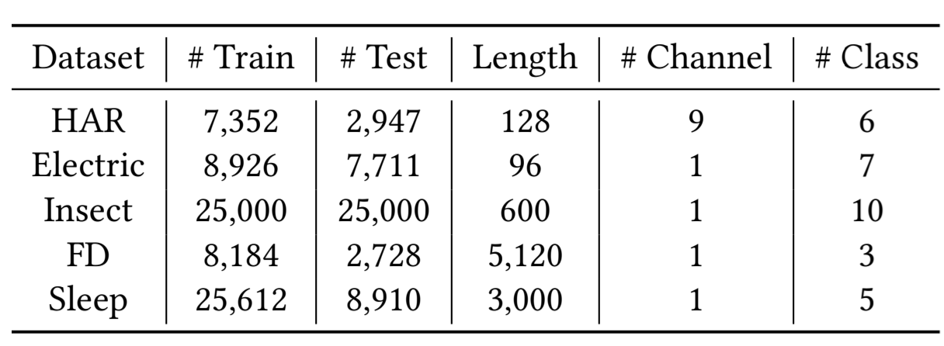
For Time Series Classification – KDD 2024
Dataset details
Evaluation Protocol
Train a synthetic data $𝒮$ by the data condensation frameworks
Train randomly-initialized models from $𝒮$
Evaluate the models on the same test dataset.
Research Questions:
RQ1: What is the performance against other baselines?
RQ2: Does the condensed synthetic data perform well in downstream tasks?
RQ3: Does the frequency information help the condensation process?
Liu, Z., Hao, K., Zheng, G., & Yu, Y. (2024, August). Dataset condensation for time series classification via dual domain matching. In Proceedings of the 30th ACM SIGKDD Conference on Knowledge Discovery and Data Mining (pp. 1980-1991).
Notes:
Let’s go through the experiment section.
We use five open-sourced time series classification datasets.
In each experiment, we first train a synthetic data by the dataset condensation framework
Then, we train randomly-initialized model from S.
Finnaly, we evaluate the models on the same test dataset.
There are three research questions and we will go through each of them.

Slide 44
For Time Series Classification – KDD 2024
RQ1: What is the performance against other baselines?
SOTA performance in all 15 settings of five datasets
Performance comparable to the full real dataset.
Liu, Z., Hao, K., Zheng, G., & Yu, Y. (2024, August). Dataset condensation for time series classification via dual domain matching. In Proceedings of the 30th ACM SIGKDD Conference on Knowledge Discovery and Data Mining (pp. 1980-1991).
Notes:
The first research question is the performance against other baselines.
ConTSC has the SOTA performance In all settings
And the performance is comparable to the full real dataset.

Slide 45
For Time Series Classification – KDD 2024
RQ2: Does the condensed synthetic data perform well in downstream tasks?
Use Neural Architecture Search as an example.
Performance of the selected model architecture
The correlation between the performance of different model architecture trained by $𝒮$ and $𝒯$.
Time consumption.
Effective in Neural Architecture Search.
Liu, Z., Hao, K., Zheng, G., & Yu, Y. (2024, August). Dataset condensation for time series classification via dual domain matching. In Proceedings of the 30th ACM SIGKDD Conference on Knowledge Discovery and Data Mining (pp. 1980-1991).
Notes:
Next, is about the downstream tasks.
We use neural architecture search as an example.
We report the accuracy of the selected model architecture.
The correlation between the performance of the model trained by S and T.
And the time consumption.
The result shows that our framework is effective and efficient in the NAS scenario.

Slide 46
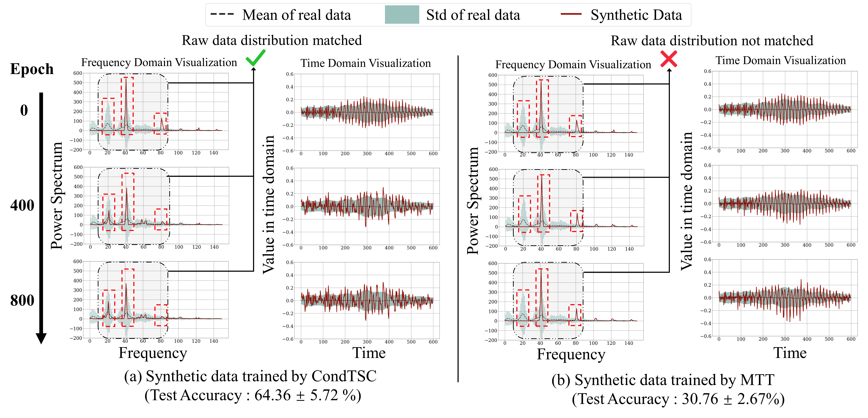
For Time Series Classification – KDD 2024
RQ3: Does the frequency information help the condensation process?
Visualize the condensed data during the condensing process.
Data condensed by CondTSC conforms to the original dataset.
Liu, Z., Hao, K., Zheng, G., & Yu, Y. (2024, August). Dataset condensation for time series classification via dual domain matching. In Proceedings of the 30th ACM SIGKDD Conference on Knowledge Discovery and Data Mining (pp. 1980-1991).
Notes:
Finally, we visualize how the frequency information help the condensation process.
We visualize the condensed data during the condensing process.
And we can see that the data condensed by CondTSC conforms to the original dataset especially in the frequency domain.

Slide 47
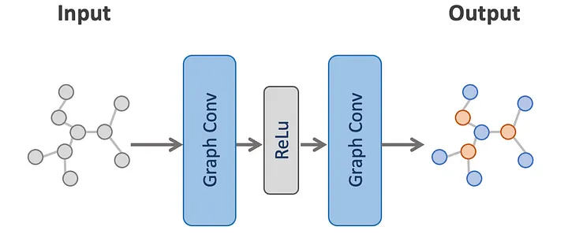
Graph Node Classification
What is Node Classification?

Slide 48
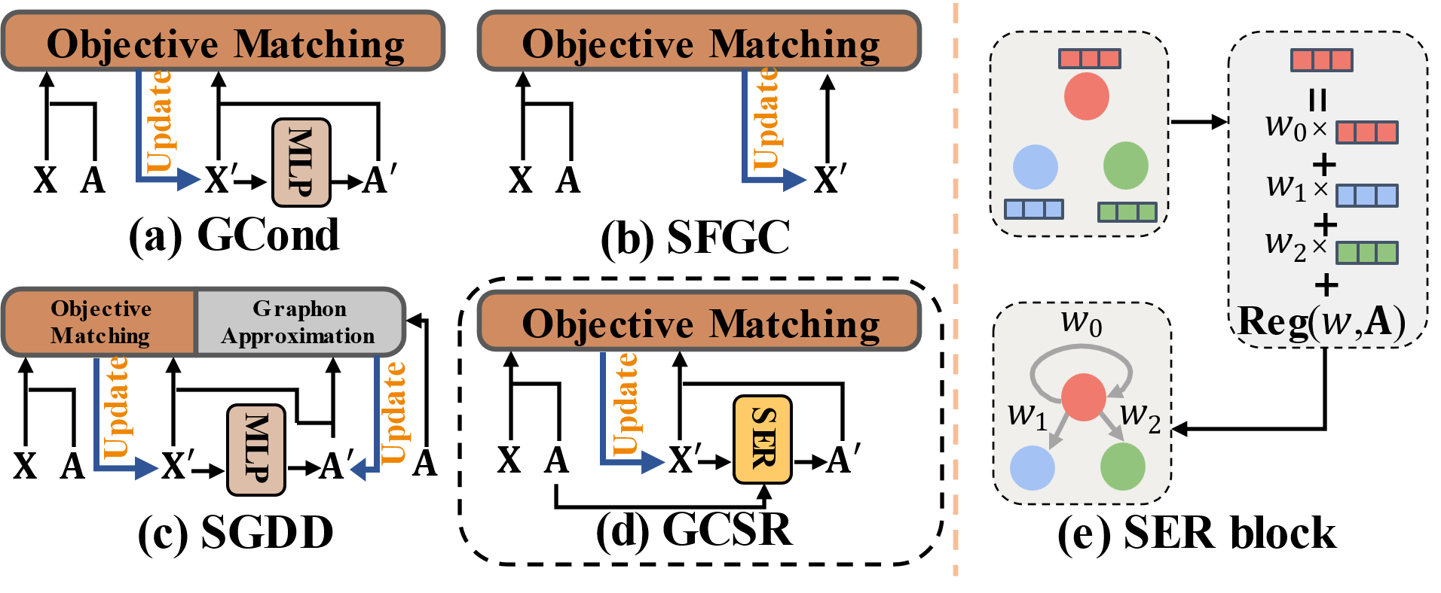
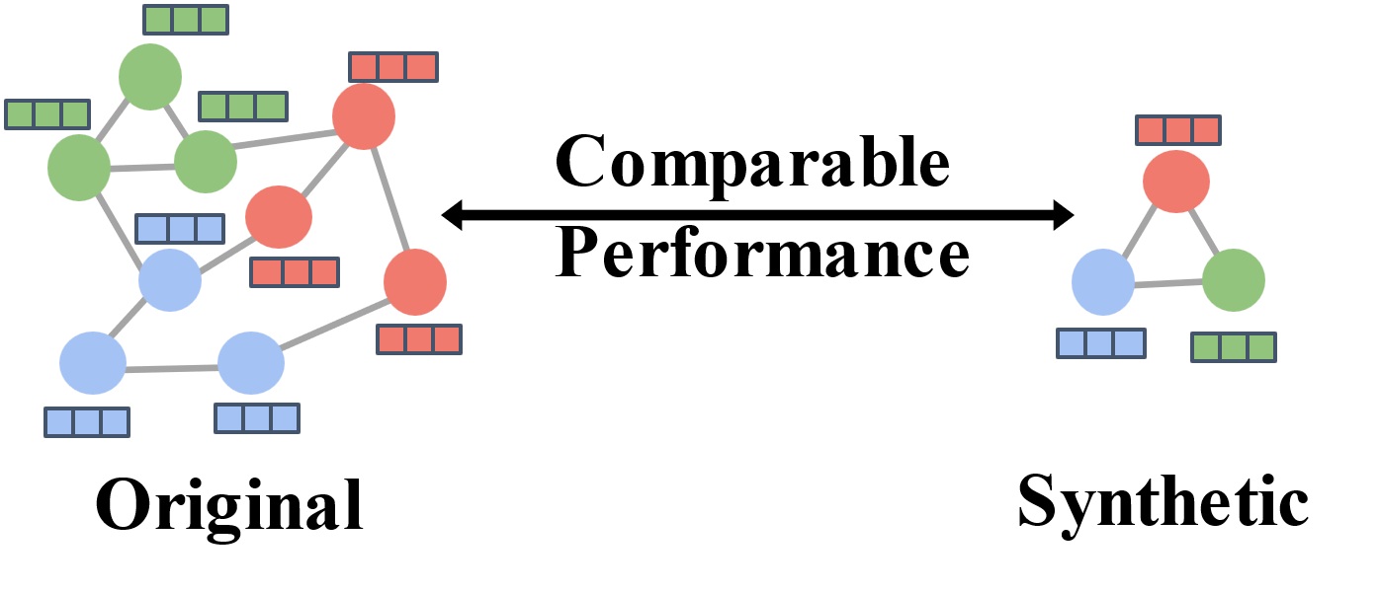
For Graph Node Classification – KDD 2024
Graph Data Condensation: Learning a small synthetic graph, such that training a model on the learned graph could achieve comparable performance.
Existing methods fail to preserve the information embedded within the original graph structure. We propose a framework to effectively leverage the original topological information.
Node & Graph Regularizer Initialization
Self-expressive Reconstruction
Parameter Matching and Bootstrapping Update
Liu, Z., Zeng, C., & Zheng, G. (2024, August). Graph data condensation via self-expressive graph structure reconstruction. In Proceedings of the 30th ACM SIGKDD Conference on Knowledge Discovery and Data Mining (pp. 1992-2002).
Notes:
Nonetheless, As shown in the following figure, most existing methods follow the paradigm of image data condensation but overlook the condensation of graph structural information.
To fill this gap, we propose a framework that effectively leverage the original structural information.
In general, our model consists of three parts: node and graph regularizer initialization, self-expressive reconstruction , and parameter matching and bootstrapping update.

Slide 49
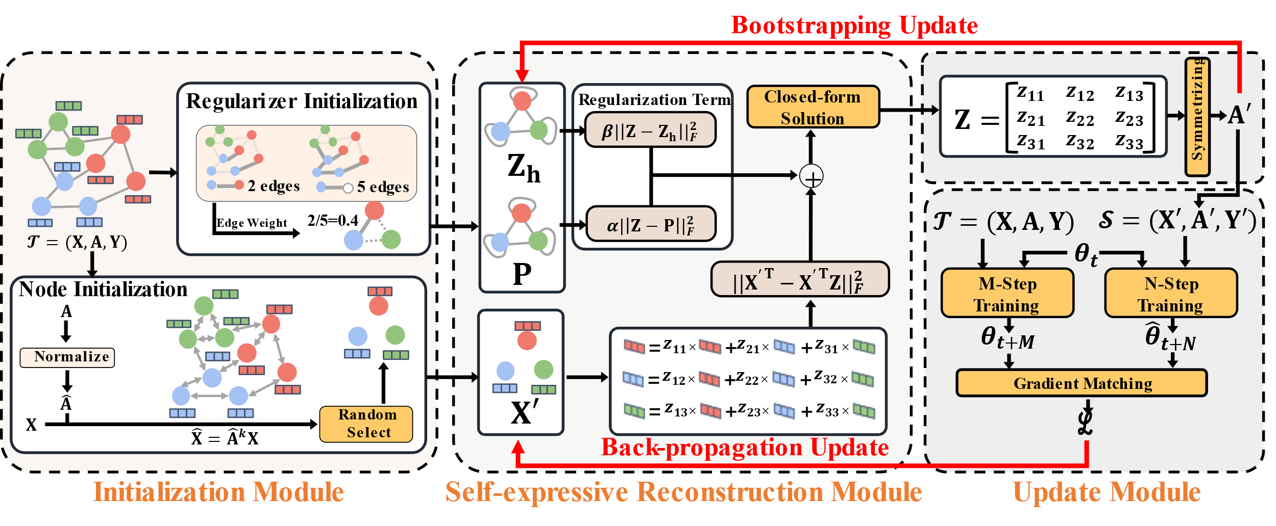
For Graph Node Classification – KDD 2024
Node & Graph Regularizer Initialization
Initialize node embedding via message passing
Fuses the graph structure information to nodes.
Extract the graph structure information as a probabilistic graph
Condenses the graph structure to align the synthetic graph.
Liu, Z., Zeng, C., & Zheng, G. (2024, August). Graph data condensation via self-expressive graph structure reconstruction. In Proceedings of the 30th ACM SIGKDD Conference on Knowledge Discovery and Data Mining (pp. 1992-2002).
Notes:
In the node and graph regularizer initialization module, we first initialize the node embedding via message passing to fuses the graph structure information to nodes.
After the message passing initialization, each node can aggregate the information of its neighbor nodes, thus having stronger representation ability. We then use the embeddings of these nodes to initialize the synthetic node.

Slide 50
For Graph Node Classification – KDD 2024
Self-expressive Reconstruction
Reconstruct the structure of synthetic graph via self-expressive
More efficient and interpretable graph structure reconstruction.
Regularizers from the original graph avoid trivial solutions and broadcast original structure.
Liu, Z., Zeng, C., & Zheng, G. (2024, August). Graph data condensation via self-expressive graph structure reconstruction. In Proceedings of the 30th ACM SIGKDD Conference on Knowledge Discovery and Data Mining (pp. 1992-2002).
Notes:
In the self-expressive reconstruction, we efficiently reconstruct an interpretable synthetic graph structure via self-expressive.
Self-expressive indicates that each data sample can be represented by a linear combination of other data points in the same subspace. For graphs, this is equivalent that the embedding of each node can be represented by a linear combination of other nodes.
These linear coefficients actually reflect the correlation between the represented node and other nodes, which could be treated as a kind of edge weight.

Slide 51
For Graph Node Classification – KDD 2024
Self-expressive Reconstruction
Reconstruct the structure of synthetic graph via self-expressive
More efficient and interpretable graph structure reconstruction.
Regularizers from the original graph avoid trivial solutions and broadcast original structure.
Liu, Z., Zeng, C., & Zheng, G. (2024, August). Graph data condensation via self-expressive graph structure reconstruction. In Proceedings of the 30th ACM SIGKDD Conference on Knowledge Discovery and Data Mining (pp. 1992-2002).
Notes:
However, as shown in this self-expressive term, where X is node embedding and Z is the coefficient matrix,
when we solve this equation by making its first-order derivative to 0, we will easily fall into the trivial solution, that is, Z is equal to identity matrix.
This is meaningless.
Hence, we add two regularization terms to limit the value of Z.
The first term is the probabilistic graph regularizer, which has been mentioned in the last slide.
It forces the probability of each edge in the synthetic graph to be the same as in the original graph.
The second term is the historical similarity matrix, which avoids drastic changes in synthetic graph.

Slide 52
For Graph Node Classification – KDD 2024
Self-expressive Reconstruction
Reconstruct the structure of synthetic graph via self-expressive
More efficient and interpretable graph structure reconstruction.
Regularizers from the original graph avoid trivial solutions and broadcast original structure.
Liu, Z., Zeng, C., & Zheng, G. (2024, August). Graph data condensation via self-expressive graph structure reconstruction. In Proceedings of the 30th ACM SIGKDD Conference on Knowledge Discovery and Data Mining (pp. 1992-2002).
Notes:
Finally, our synthetic graph structure is computed using these close form solution.

Slide 53
For Graph Node Classification – KDD 2024
Parameter Matching and Bootstrapping Update
Simulate the training dynamics of the real graph
Multi-step Gradient Matching: $ℒ=\frac{||\hat{θ}−\overline{θ}||}{||θ_{0}−\overline{θ}||}$
Avoid overfitting and remove noise from the original graph structure
Bootstrapping Update: $Reg=τReg+\left(1 − τ\right)A^{′}$
Liu, Z., Zeng, C., & Zheng, G. (2024, August). Graph data condensation via self-expressive graph structure reconstruction. In Proceedings of the 30th ACM SIGKDD Conference on Knowledge Discovery and Data Mining (pp. 1992-2002).
Notes:
The last module is parameter matching and bootstrapping Update, where we update the synthetic node embedding via multi-step gradient matching, that is, given a neural network parameterized by theta t, we optimize it with synthetic dataset S for N epochs to generate the trained parameter theta hat t + n and optimize it with real dataset T for M epochs to geberate theta t + m.
These two parameters are aligned, such that the synthetic graph could simulate the training dynamics of the real graph.
In addition, we also bootstrappingly update the regularizers, to avoid overfitting to the probabilistic graph and remove noise from the original graph structure.

Slide 54
For Graph Node Classification – KDD 2024
Dataset details
Evaluation Protocol
Train a synthetic data $𝒮$ by the data condensation frameworks
Train randomly-initialized models from $𝒮$
Evaluate the models on the same test dataset.
Liu, Z., Zeng, C., & Zheng, G. (2024, August). Graph data condensation via self-expressive graph structure reconstruction. In Proceedings of the 30th ACM SIGKDD Conference on Knowledge Discovery and Data Mining (pp. 1992-2002).

Slide 55
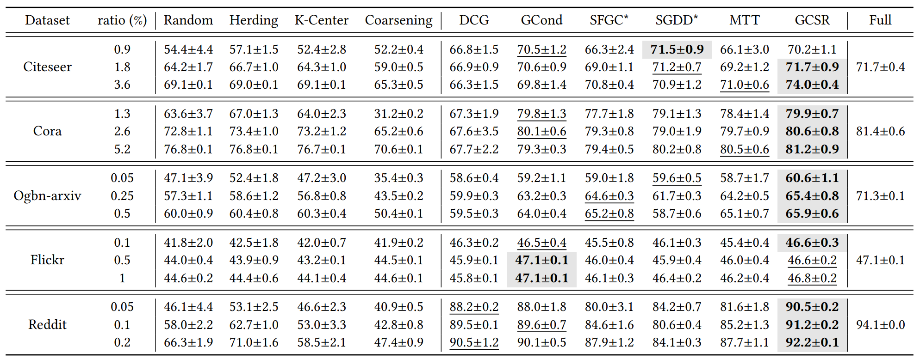
For Graph Node Classification – KDD 2024
Competitive performance in all 15 settings of five datasets
Performance comparable to the full real dataset.
Robustness under different condensation networks.
Liu, Z., Zeng, C., & Zheng, G. (2024, August). Graph data condensation via self-expressive graph structure reconstruction. In Proceedings of the 30th ACM SIGKDD Conference on Knowledge Discovery and Data Mining (pp. 1992-2002).
Notes:
Experiments show that our method achieve competitive performance under different datasets and condensation ratio.
What’s more, the performance is comparable to the real dataset.

Slide 56
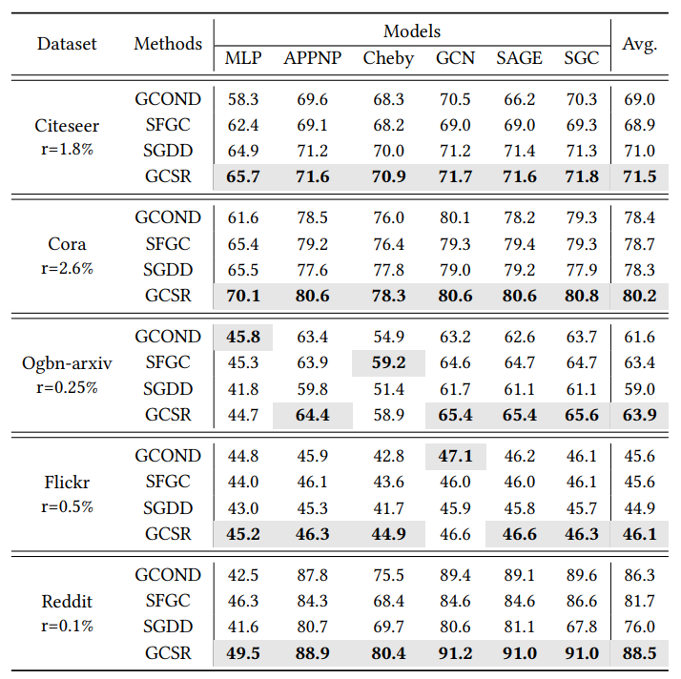
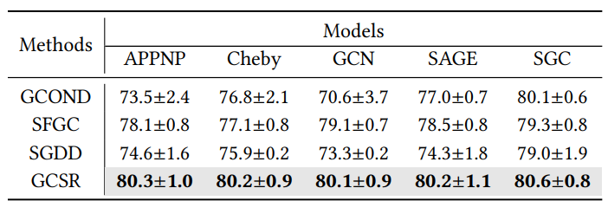
For Graph Node Classification – KDD 2024
Stable performance and generalization across different neural networks.
Robustness under different condensation networks.
All modules contribute to the performance.
Liu, Z., Zeng, C., & Zheng, G. (2024, August). Graph data condensation via self-expressive graph structure reconstruction. In Proceedings of the 30th ACM SIGKDD Conference on Knowledge Discovery and Data Mining (pp. 1992-2002).
Notes:
our method exhibits stable performance and generalization across different neural networks, where we condense the graphs with sgc and test the synthetic graphs using different neural architecture, like mlp, appnp, cheby net, gcn and so on.
Different from other methods, our methods is model-insensitive and performs smoothly across different GNN architectures for condensation. Notably, among all these architectures, SGC is the simplest one but surpasses others in all methods. This indicates that a more complex GNN model in condensation does not necessarily bring better optimization results since it complicates the parameter matching process.
In ablation study, we test the effectiveness of each module, that is , message passing initialization module MPI and self-expressive reconstruction module SER. The results reveal that the joint use of these modules bring sota performance.

Slide 57
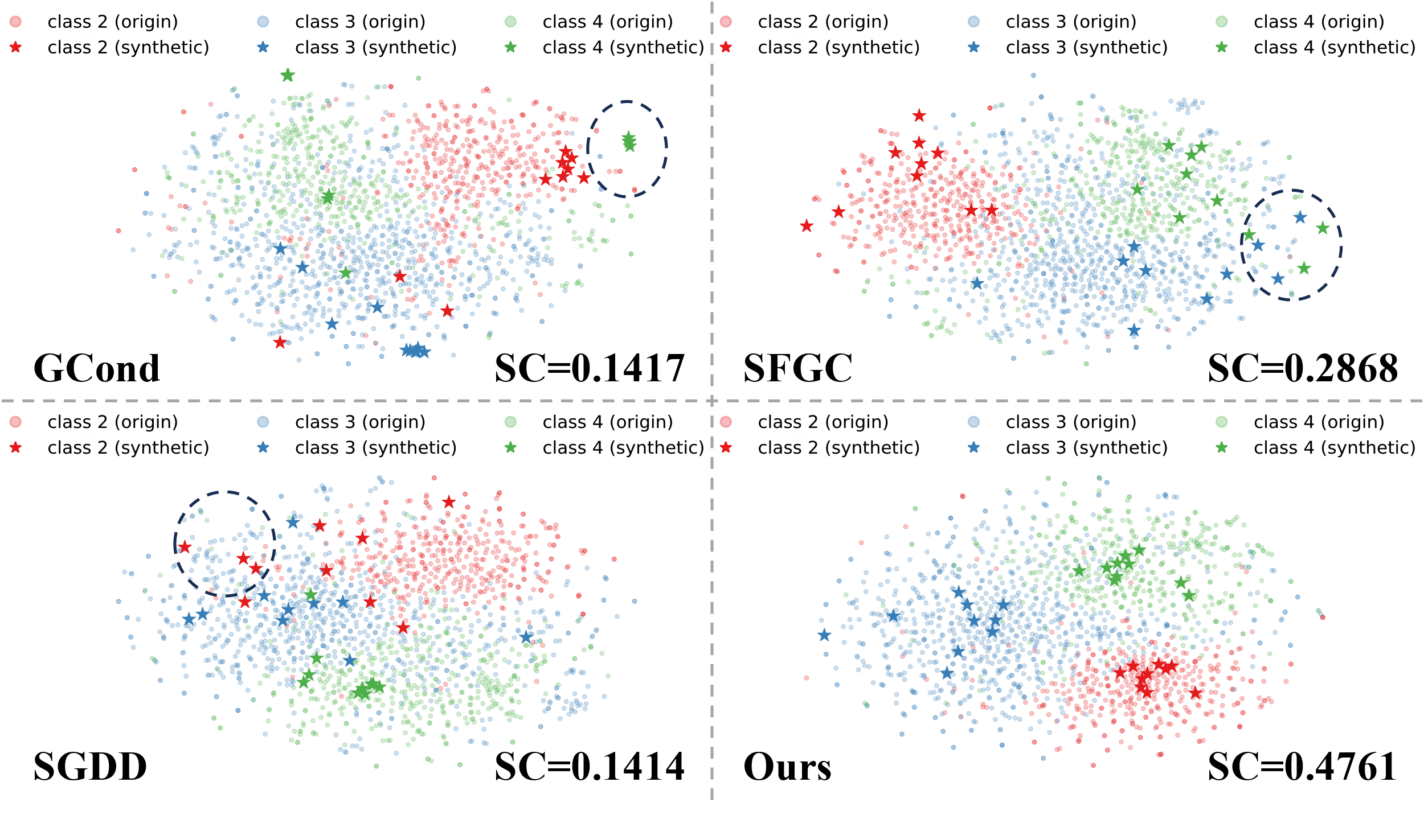
For Graph Node Classification – KDD 2024
Greater similarity between the original and synthetic node embedding.
Greater similarity between the original and synthetic graph structure
Liu, Z., Zeng, C., & Zheng, G. (2024, August). Graph data condensation via self-expressive graph structure reconstruction. In Proceedings of the 30th ACM SIGKDD Conference on Knowledge Discovery and Data Mining (pp. 1992-2002).
Notes:
In addition to node classification accuracy, we also use visualization to compare the synthetic graphs generated by different methods.
In the top figure, we use t-SNE to visualize the real and synthetic node features of Cora condensed by four different methods.
It shows that Data learned by other methods is not well conformed to the distribution of the original data, and some nodes are mixed up with nodes of other classes while Data learned by our methods obeys the distribution of the original data and exhibits a distinct separation between different classes.
This could lead to better classification performance and evident distribution characteristics.

Slide 58
Thanks For Listening
刘展宇
zhyliu00@sjtu.edu.cn

